Slide 1



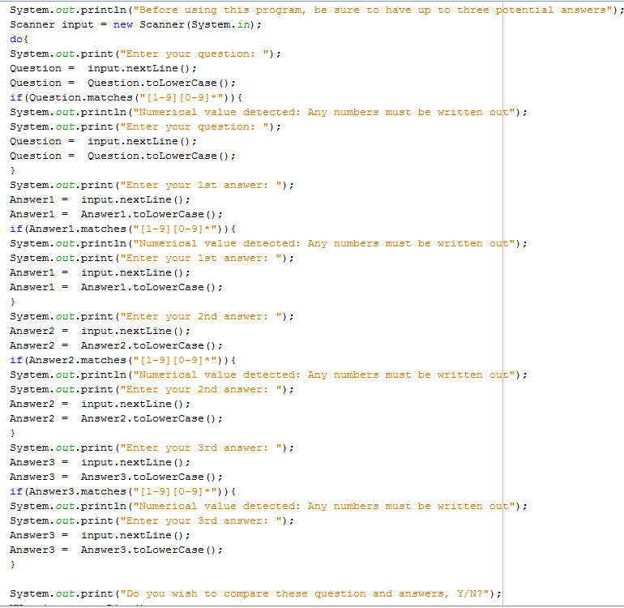
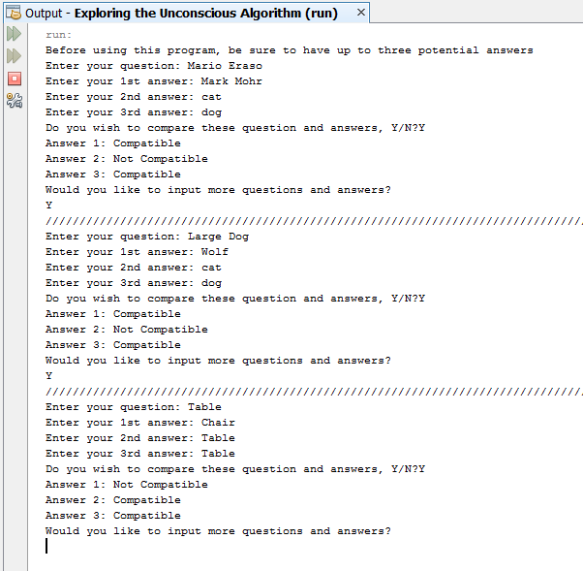
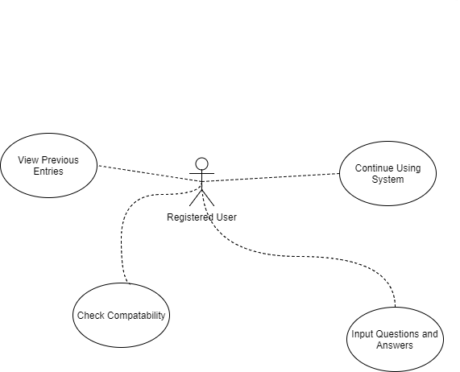
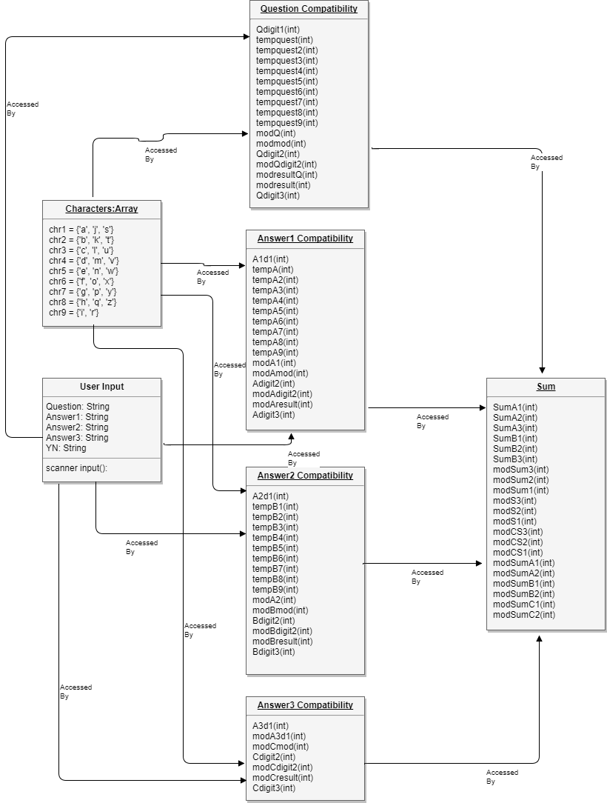
School of Computing & Information Sciences
Senior Project, 2017, Summer
Exploring the Unconscious
Student: Ruben, Florida International University
Mentor: Mario Eraso, Florida International University
Instructor: Masoud Sadjadi, Florida International University
Problem
People sometimes have multiple answers to a personal question.
People struggle to choose between these answers.
People wonder if the answer they chose was the best one.
What people truly want is usually locked in their unconscious mind.
People struggle to connect with their unconscious mind.
Solution
Create a system for testing the compatibility of questions and answers.
System allows the user to see which answer best suits their question.
System will help the user connect with their unconscious like in the I Ching, but using a mathematical algorithm instead of using hexagrams.
Current System
Allows the user to enter one question and three answers at a time.
The system determines whether or not the answer is compatible with the question.
Allows user to input more questions and answers without restarting system.
Does not allow user to input numerical values.
Screenshots
Requirements
Allow user to input a question.
Allow user to input three answers.
Allow user to see which answers were compatible and which were not.
Allow user to continue using the system as long as they wish.
Allow user to look back at previous inputs and their compatibility.
System Design
Implementation
The system was implemented using Java coding.
The Netbeans platform was used to both create the system and to upload it to GitHub.
Data was stored and run through a series of arrays and for loops.
Data was outputted to the user using a system of if statements.
Verification
Test Case ID | Purpose | Results
Test 1 | Test whether the system runs the compatibility function. | PASS
Test 2 | Test that the compatibility function will run for more than one answer. | PASS
Test 3 | Test that the computations performed by the compatibility function are mathematically correct based on the algorithm provided. | PASS
Test 4 | Test whether the system prevents the user from inputting numeric values. | PASS
Test 5 | Test whether the user can continue using the system after the initial input. | PASS
Test 6 | Test the compatibility of the phrase “large dog” with “wolf”, “dog” and “cat”. | PASS
Test 7 | Test the compatibility of two names “Mario Eraso” and “Mark Mohr”. | PASS
Test 8 | Test the compatibility of the word “table” with itself. | PASS
Test 9 | Test whether the system will output a “Not Compatible” for the words “bus” and “car”. | FAIL
Test 10 | Test revised code for whether it outputs a “Not Compatible” for the words “bus” and “car”. | PASS
Test 11 | Test to make sure all variables are reset after each iteration of the program. | PASS
Object Design
Summary
The system provides a platform for the user to connect to their unconscious.
The system tests the compatibility of words and phrases.
The system allows the user to continue using it after their initial input.
Acknowledgement
The material presented in this poster is based upon the work supported by Mark Mohr and Mario Eraso I am thankful to the help that I received from my group members, Daniel Antonio .
Notes:
1

